Slide 1
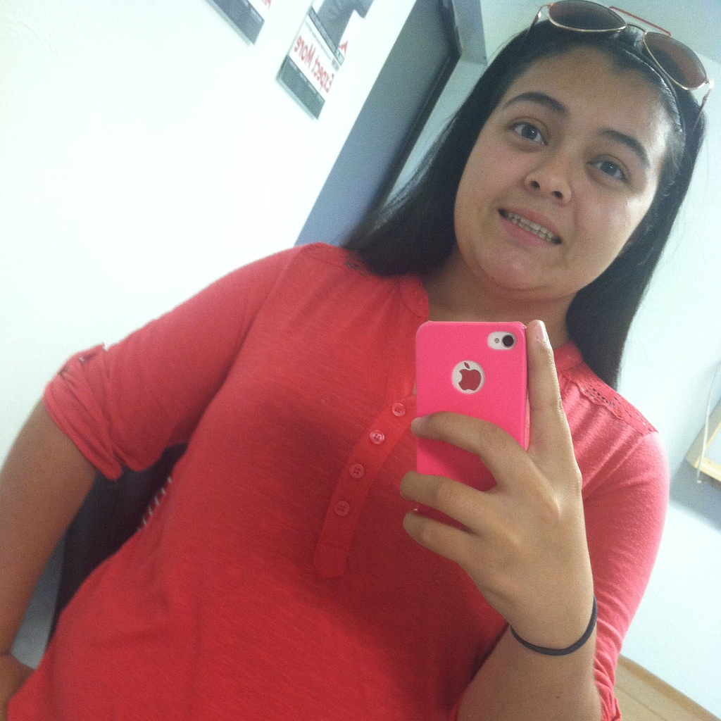
Exit Interview
Veronica Espinoza

Slide 2
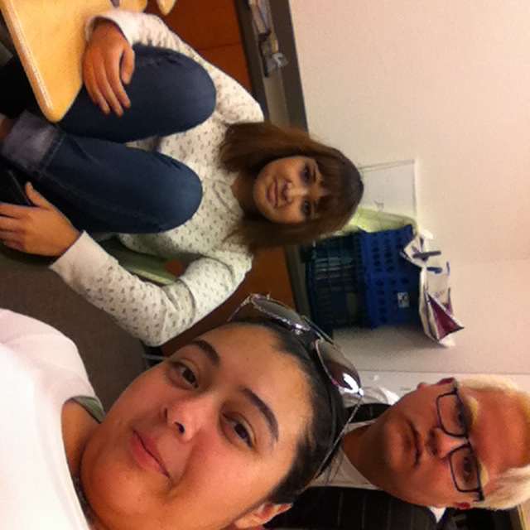
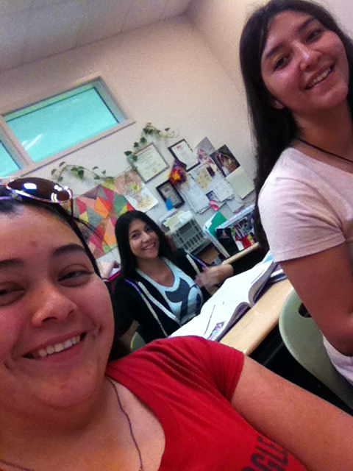
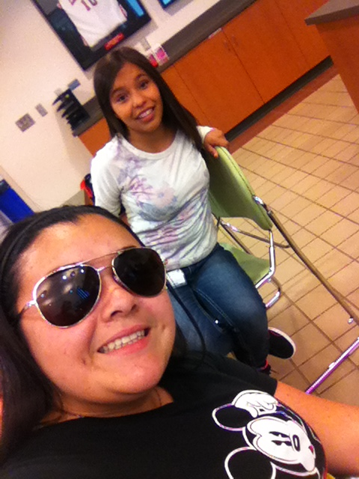
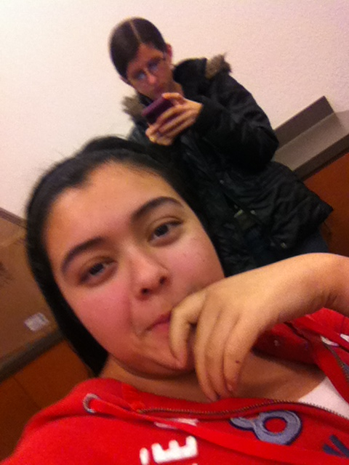
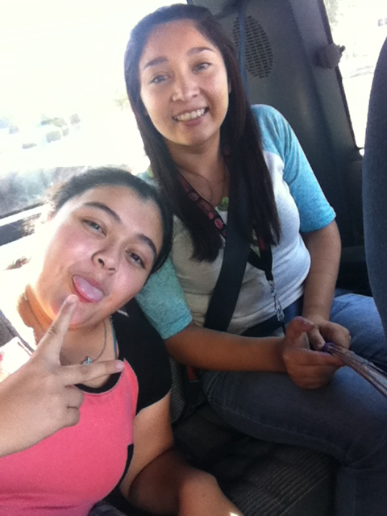
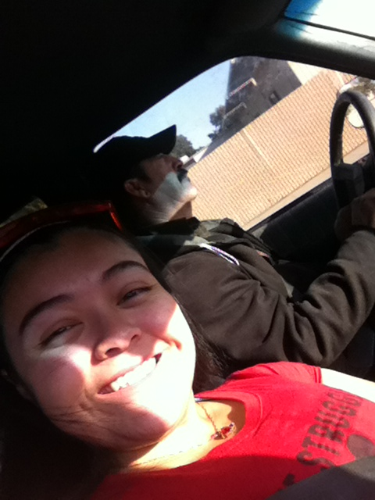
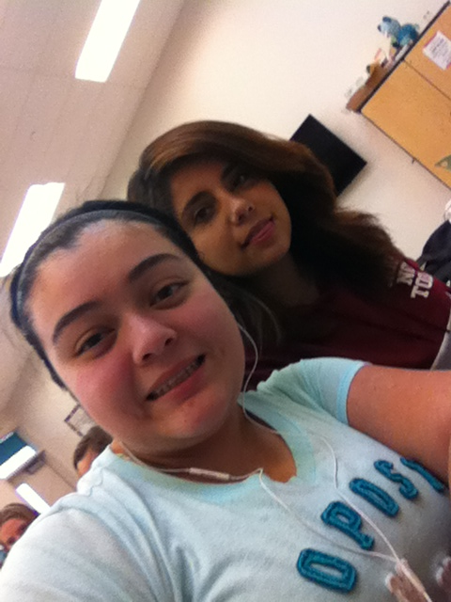
About Me
Born here in Lindsay in the year 1999
I have lived in Lindsay my whole life with both my parents, my two older siblings Sandra and Oscar, my little nephew Dominic and my sister in law Rosa.
Youngest of three
Talent: quick learner
Interests: drawing, basketball, music
procrastination/managing time to do my work

Slide 3
High School Experience
PBS system
Success- learning how to be a productive learner, I tried to focus on school and distanced myself from distractions.
It will help me focus on school
Deadlines/procrastination- struggle
Overcame it by learning to manage my time more wisely and focusing on my school work and not on distractions.
Learned that it doesn’t matter if I pass my classes or not because in the end it will be my fault if I don’t graduate or pass the class.
Things I’ve learned about myself as a student
I can work hard under stress
Better as an independent learner
How has high school prepared me for my next steps/college/career
With deadlines and consequences for failing to turn in work by the deadlines I’ve learned how it will be in college.
Taking Ap classes with rigorous work
Classes similar to college: work at college level
English 251, English 1
Ap Spanish language, Ap Spanish Lit. (pathway)
APUSH

Slide 4
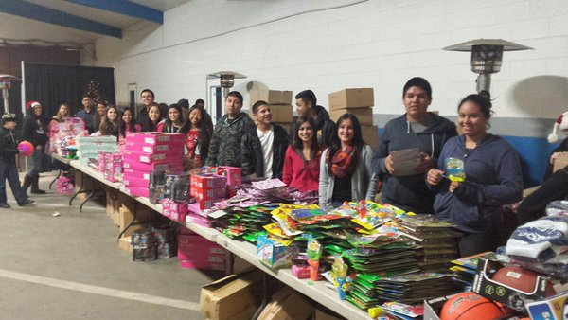
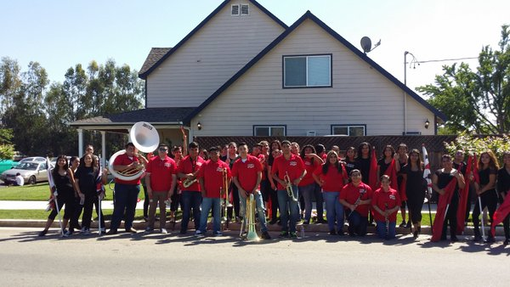
Memorable moments- being involved in clubs, events
KEY CLUB:
ASL CLUB:
DRAMA CLUB:
ART CLUB:
COLOR GUARD CLUB:
Notes:
Good and bad experiences in lhs

Slide 5
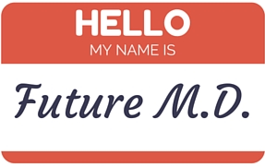
JOB SHADOW
I job shadowed my doctor: Elisa Garcia
It connects to my future because I plan on pursuing a career in the medical field and becoming a doctor.
Interest in science
Helping people
Overall, the experience I had was good because I had the chance to witness how it would be like a day in this career.
Getting to see first hand how a doctor works
It suits me because I have always wanted to work in a career in which I can help people .
I can see myself working in this field because it seems very interesting

Slide 6
Pathway -Spanish
Spanish it seemed easy and to better my fluency in the language
It will be very helpful because the majority of people speak Spanish so it helps to be bilingual.
That there are different cultures
I am currently in my third year of my pathway, AP Spanish Literature. I chose this pathway, because I believed that it would help me later in life and because I have always wanted to better my fluency in the language.
Spanish Speakers 2P
AP Spanish Language
AP Spanish Literature

Slide 7
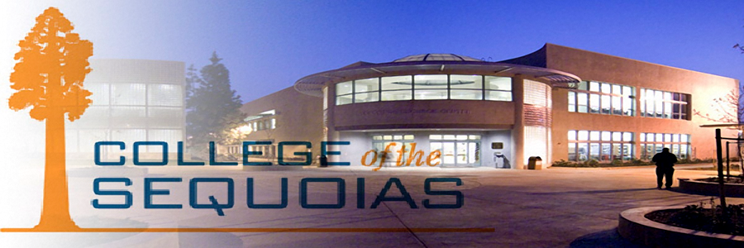
Post-High School Plans
COS for 2 years then transferring to a university
College or career?- I plan on double majoring in Biology and Criminal Justice, pediatrician or a detective maybe both.
Status of applications and acceptances
It helps me get all my pre requisites out of the way so that I can focus on the most important classes when I go to a University and then Medical school.
family/financial support – both of my parents support me and want me to continue my education and pursue a career in something that interests me.
Goals
Short term : graduate and go to college
Long term : become a doctor

Slide 8
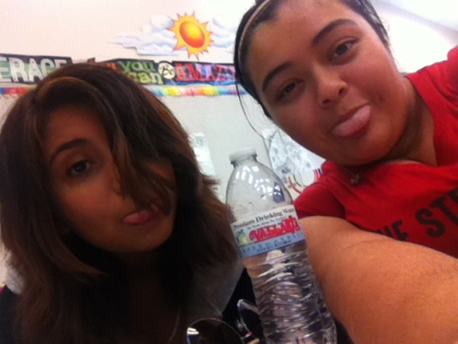
Leaving LHS
I have made many friends, met new people and have had the chance to meet some wonderful, inspirational and motivating people.
Counselors which have pushed us to stay on pace and helping us with our college applications.
Teachers like Mr. Gutierrez who have tried to help us ensure that we graduate and get into college.
It has provided me with insight on how life will be at college and after high school going on to a career.
PBS has taught me that I need to learn how to manage my time between free time, work and school.
After graduating from LHS, I plan on attending COS for two years and then transferring to a University.
Stanford University or Fresno State
Major- Biology and Criminal Justice
I chose these majors because I believe that they will provide me with a way to help people.
Motivation: myself and my parents because I want to make them proud of me and I want to do something with my life.

